Slide 1
Hysteresis Comparator

Slide 2
Comparator
A device that compares two voltages levels and outputs a digital signal indicating which is larger. It has two analog input terminals and one binary digital output.

Slide 3
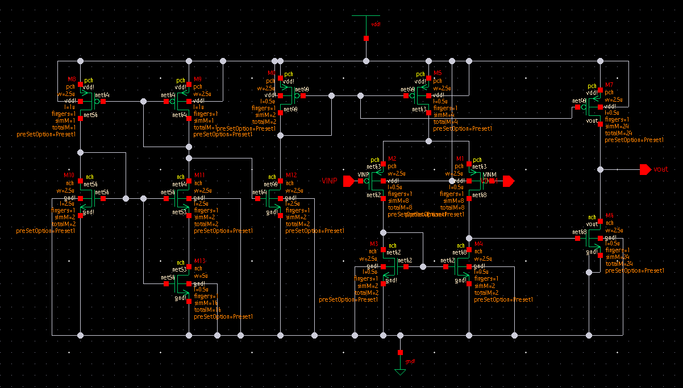
Two-Stage Op-Amp as Comparator
Notes:
This is an Inverting Comparator. That is, if Vin > Vref, Vo = 0 and if Vref < Vin, Vo = 1

Slide 4
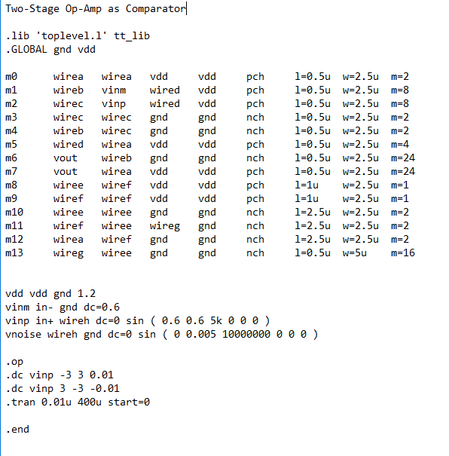
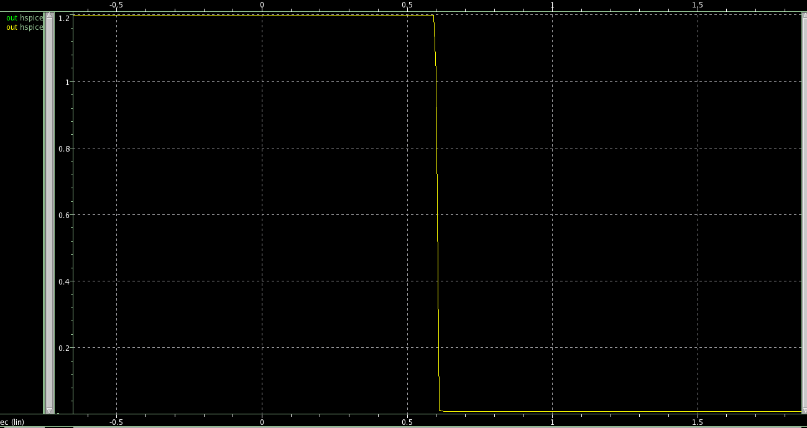
Notes:
The diagram in the right shows the dc curves of the two-stage op-amp with the vinp increasing (negative to positive) and decreasing (positive to negative). For both curves, the transition (0 to 1 & 1 to 0) happens at the same exact input values which explains why the two curves are overlapping.

Slide 5
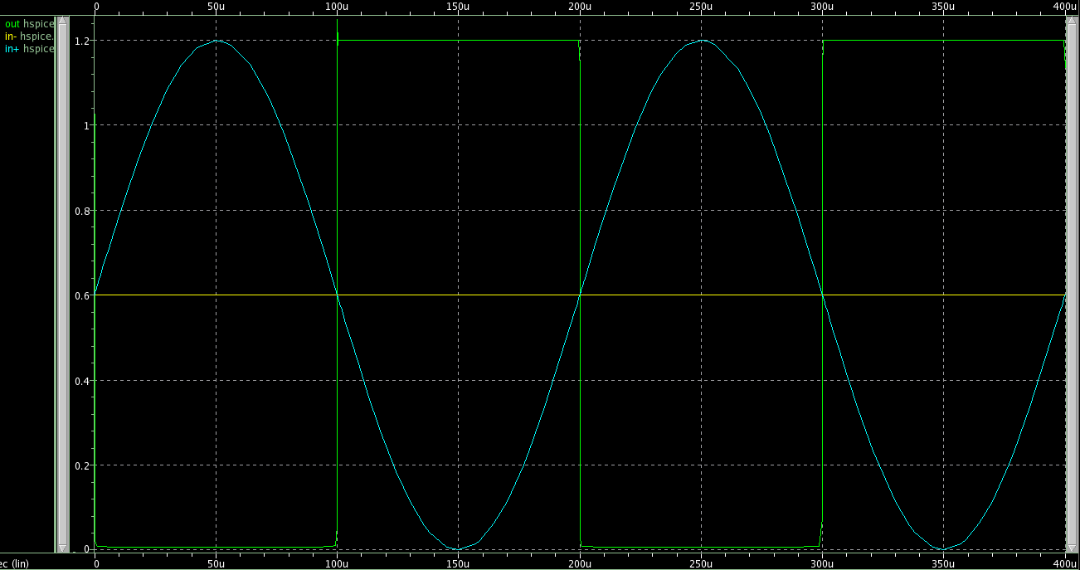
Notes:
This is an Inverting Comparator. That is, if Vin > Vref, Vo = 0 and if Vref < Vin, Vo = 1

Slide 6
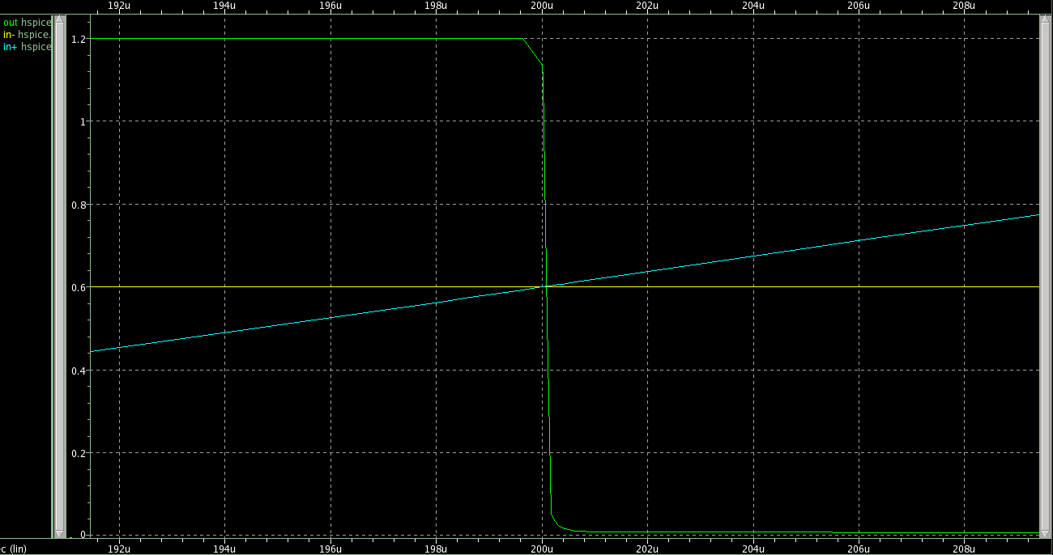
Notes:
Taking a closer look at the transition time, the transition from 0 to 1 or 1 to 0 of the output voltage occurs almost instantaneously with the switching of the levels of the reference voltage and input voltage.

Slide 7
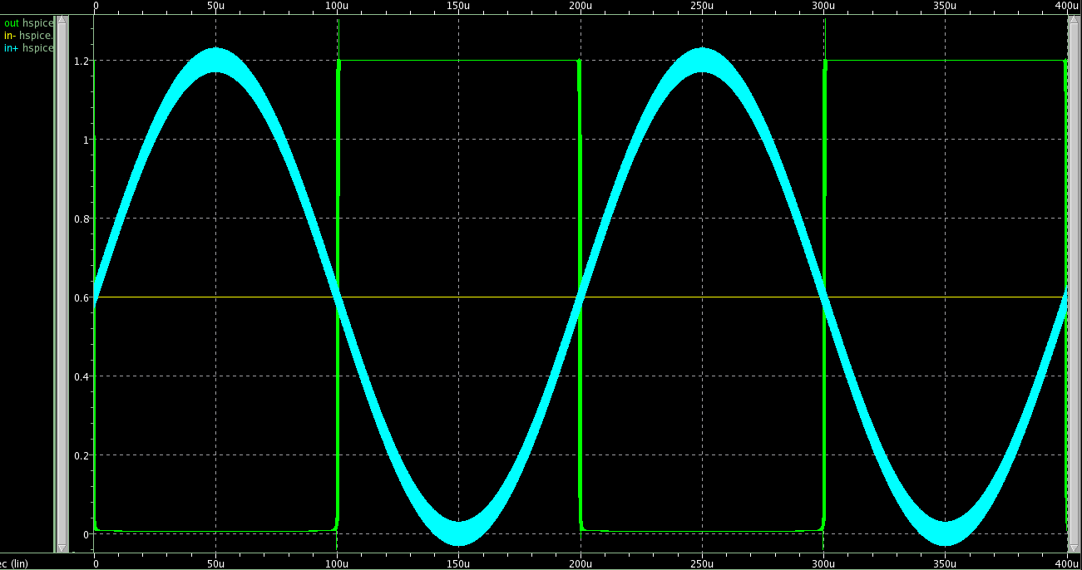
Metastability
Notes:
Noise is added to the input signal by connecting in series a voltage source with low amplitude and high frequency (10MHz) to the vinp. Then we zoom in to the transitioning part of the graph.

Slide 8
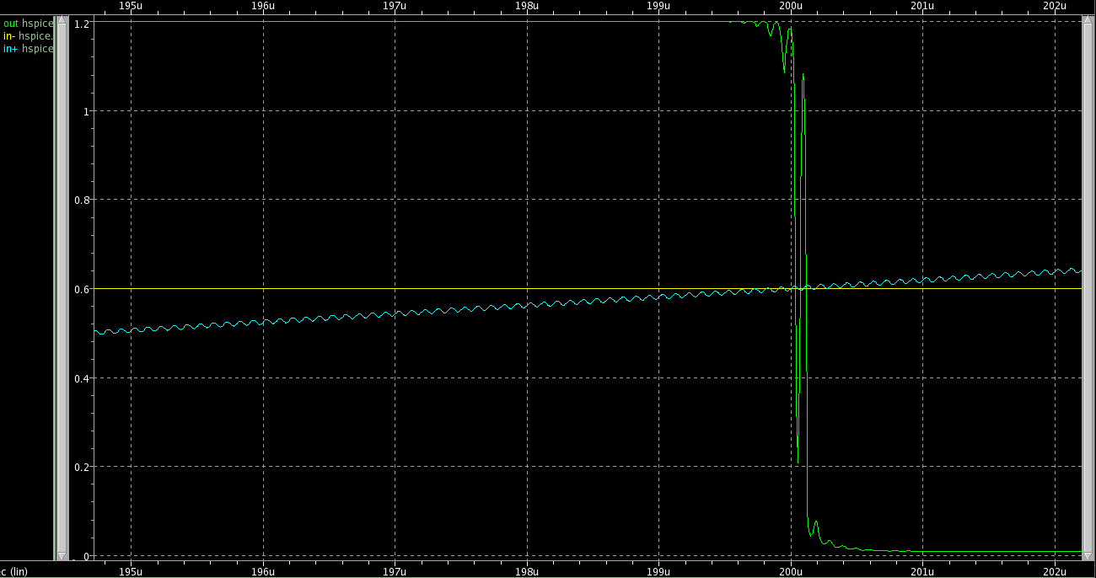
Notes:
Noise = 10mVpp

Slide 9
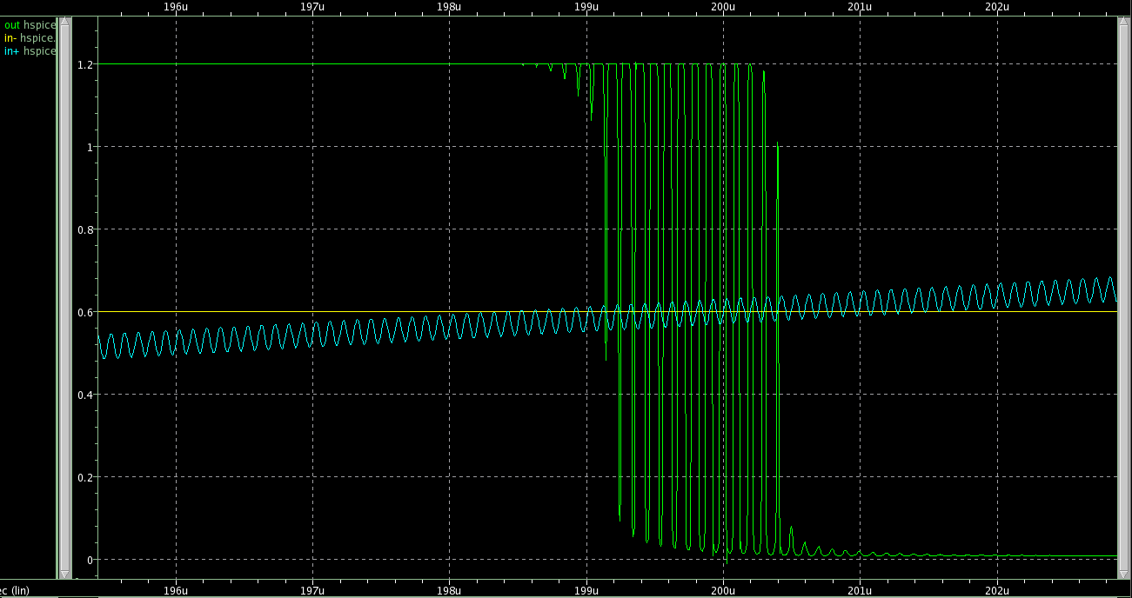
Notes:
Noise = 60mVpp

Slide 10
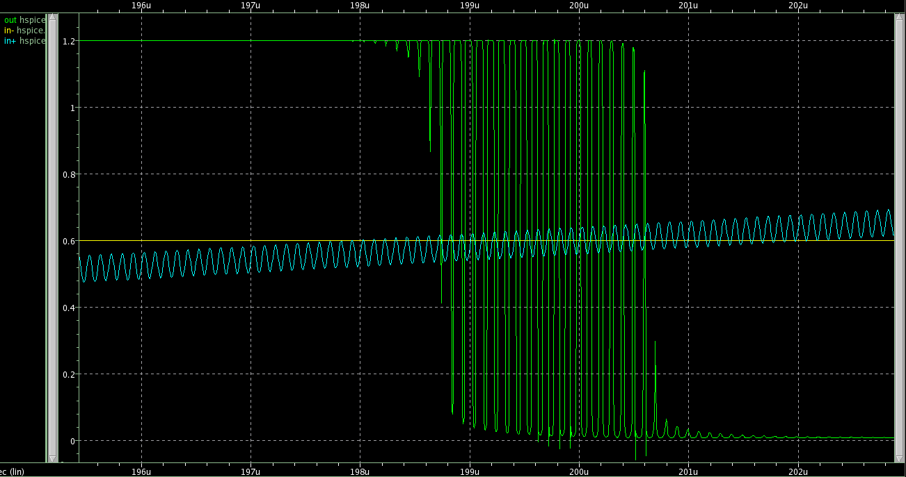
Notes:
Noise = 80mVpp

Slide 11
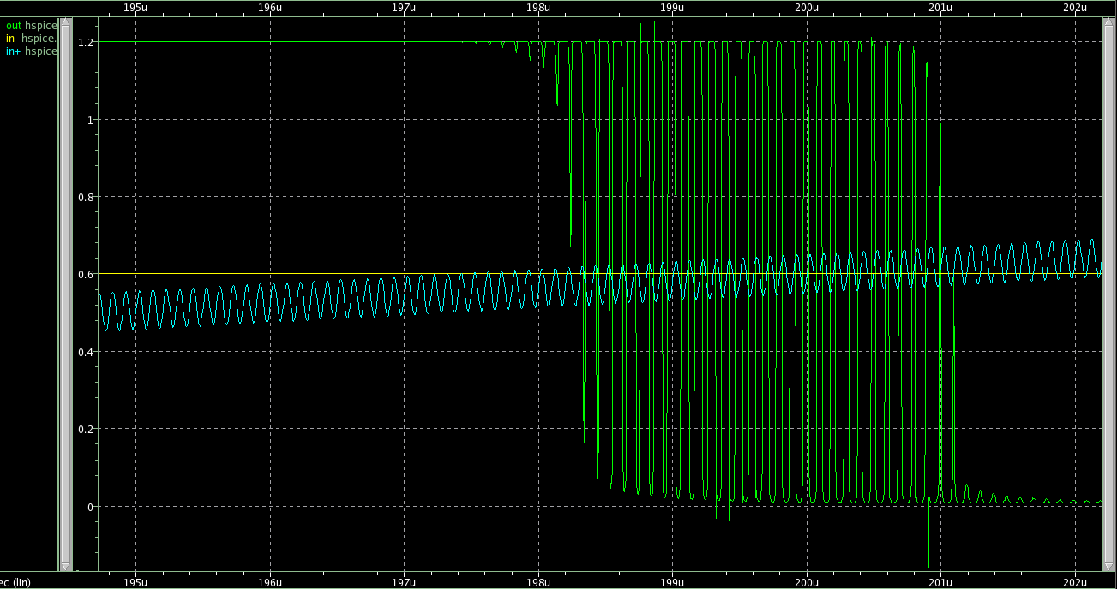
Notes:
Noise = 100mVpp

Slide 12
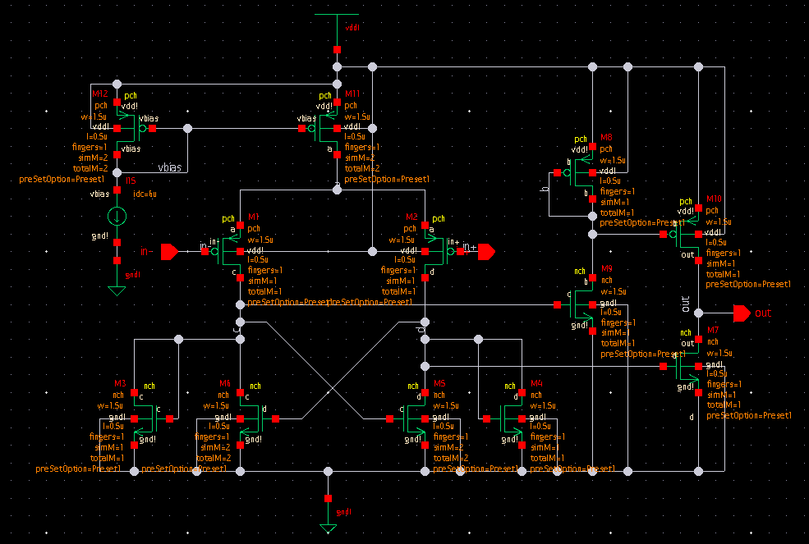
Comparator with Hysteresis
Notes:
This is a non-inverting comparator. That is, if Vin > Vref, Vo = 1 and if Vref < Vin, Vo = 0

Slide 13
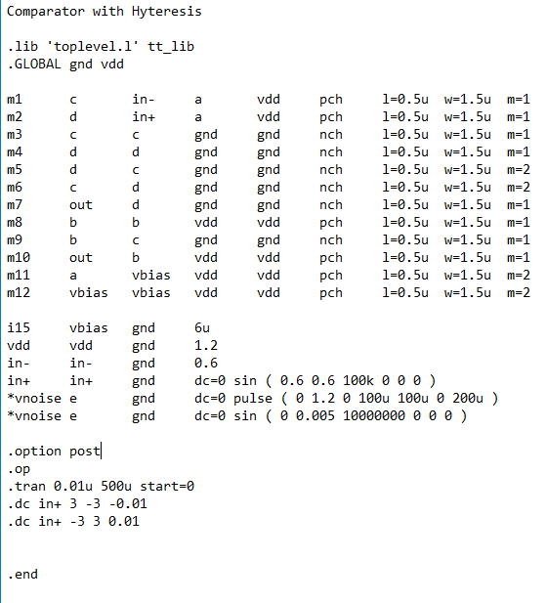
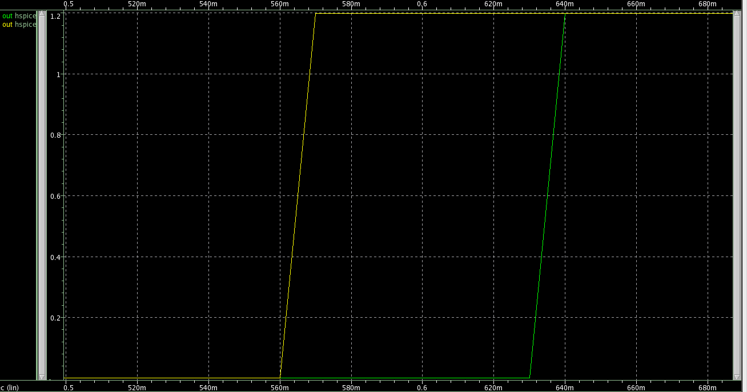
Notes:
The diagram in the right shows the dc curves of the two-stage op-amp with the vinp increasing (negative to positive) and decreasing (positive to negative).

Slide 14
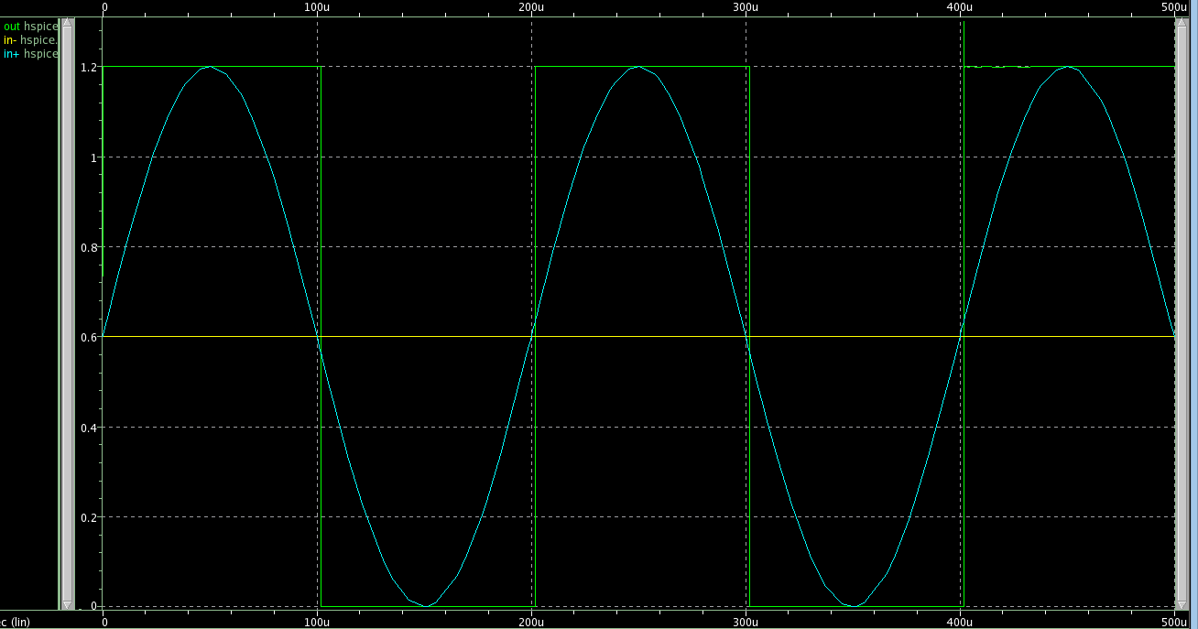
Notes:
This is a non-inverting comparator. That is, if Vin > Vref, Vo = 1 and if Vref < Vin, Vo = 0. We then zoom in to transitioning parts.

Slide 15
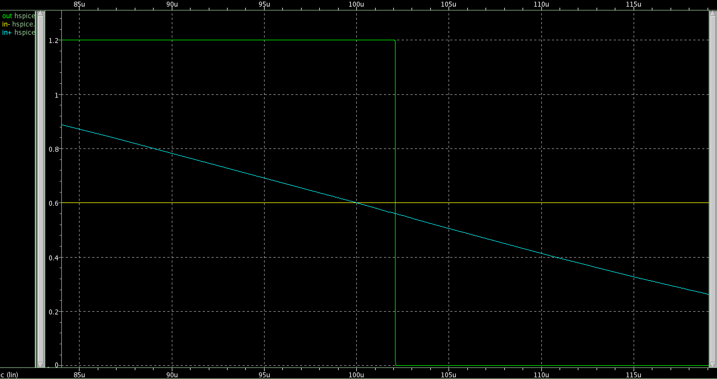
Notes:
For a comparator with a hysteresis, the value of the output does not change until the value of the input reaches a certain threshold.

Slide 16
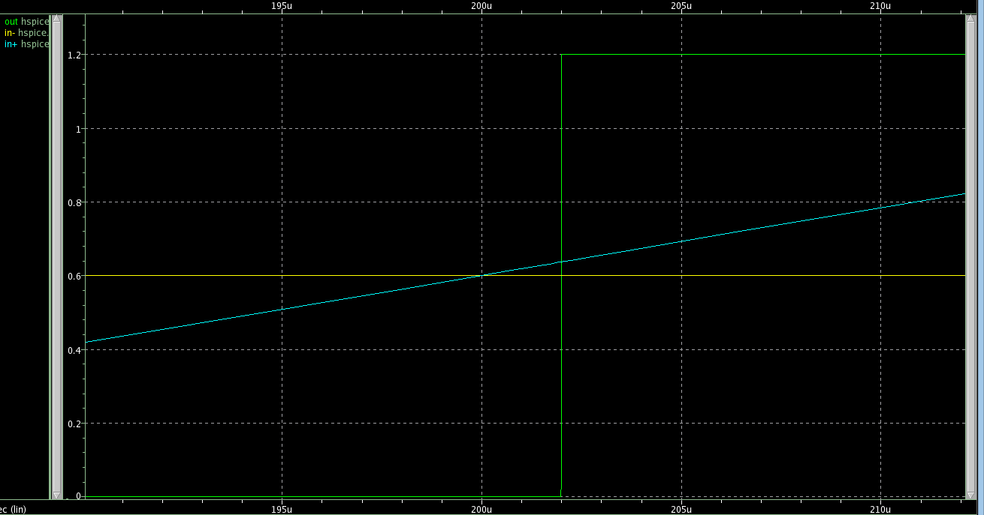

Slide 17
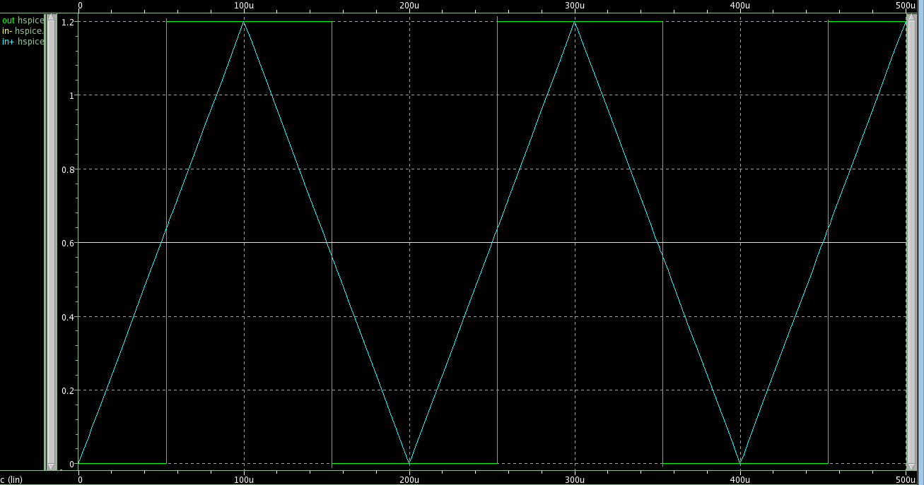
Notes:
Triangular wave input.

Slide 18
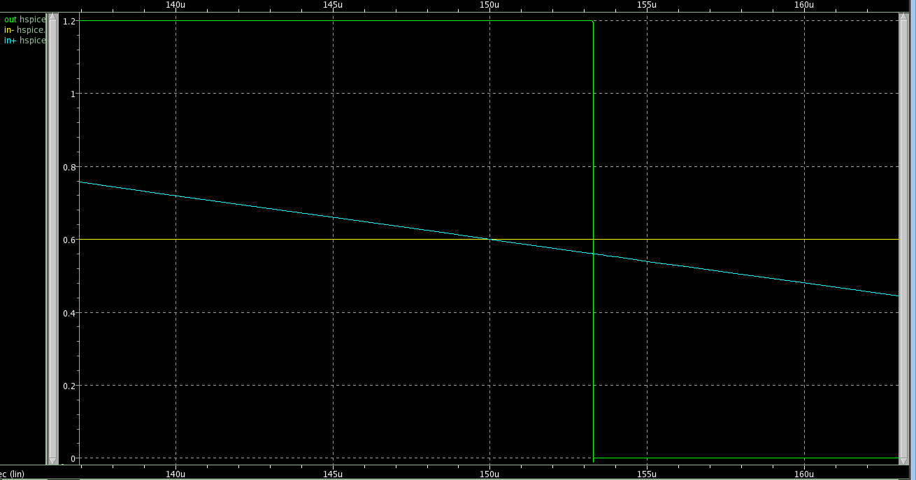

Slide 19
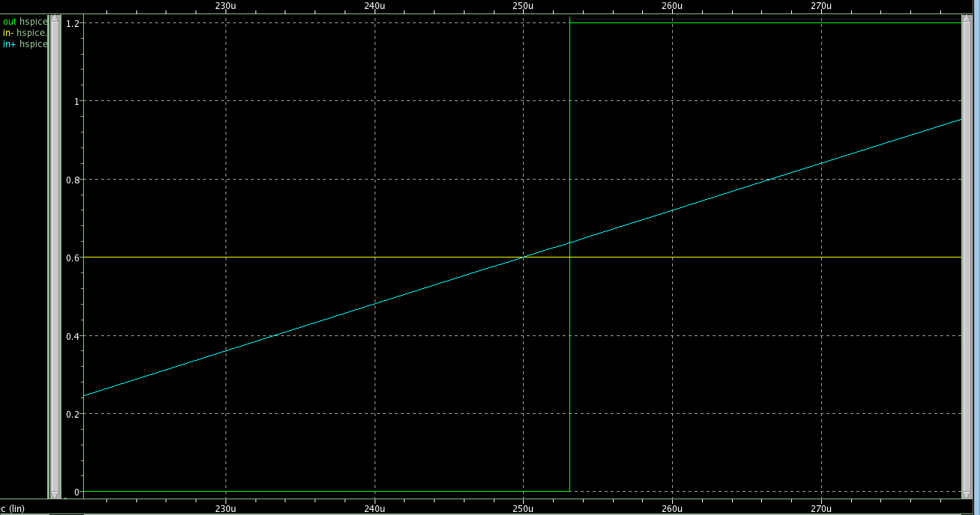

Slide 20
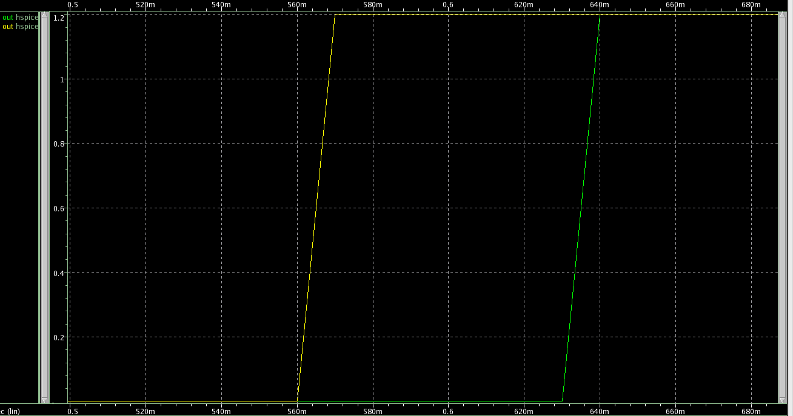

Slide 21
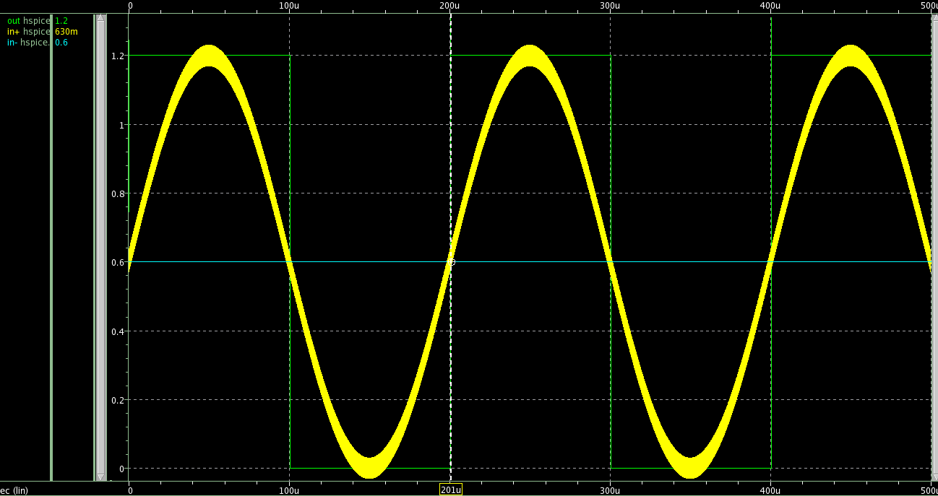
Avoiding Metastability

Slide 22
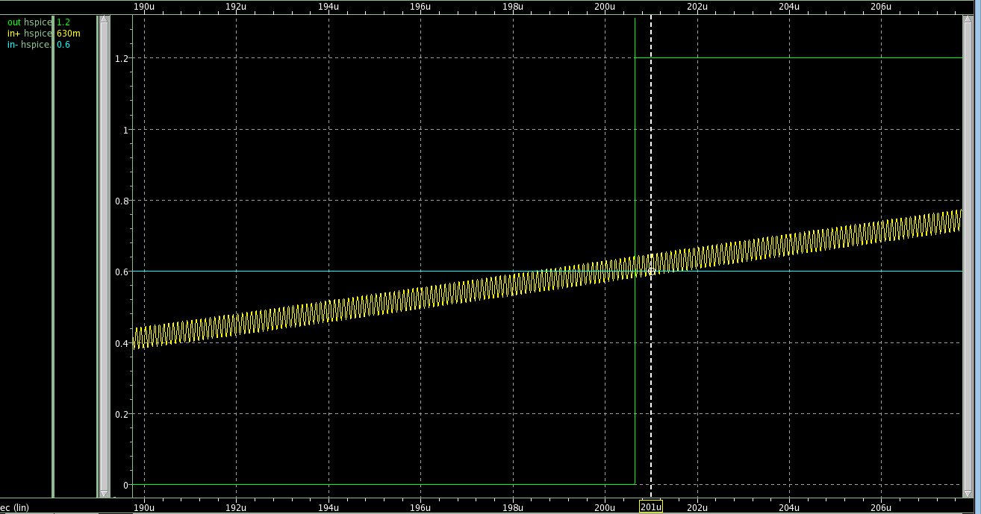
Notes:
Noise = 60mVpp

Slide 23
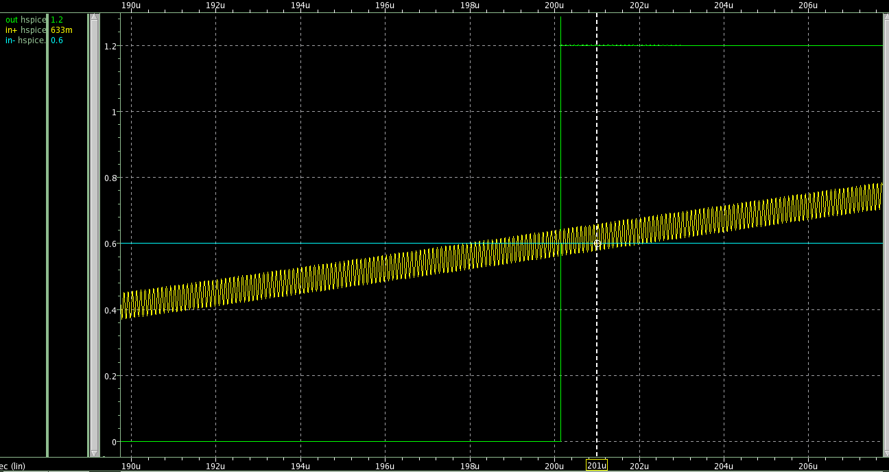
Notes:
Noise = 80mVpp

Slide 24
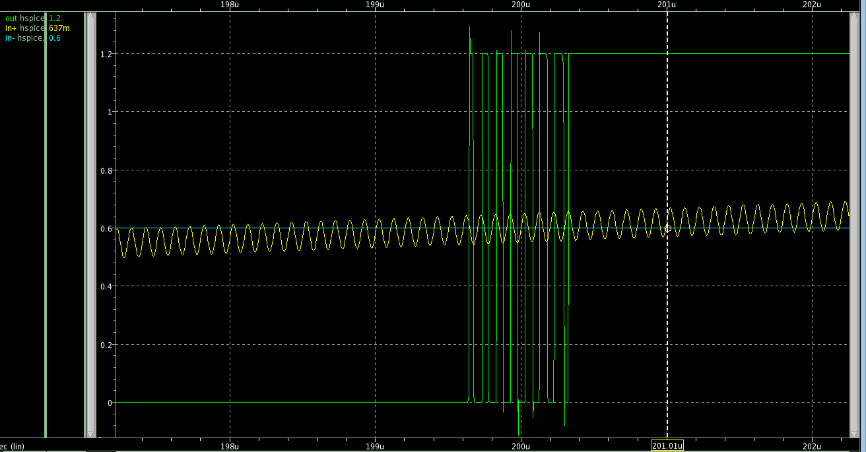
Notes:
Noise = 100mVpp

Slide 25
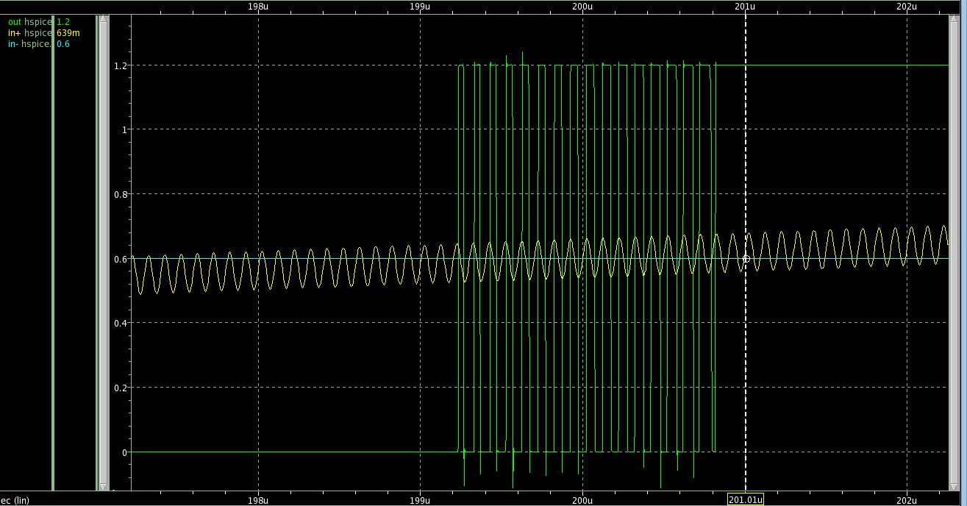
Notes:
Noise = 120mVpp

Slide 26
Effects of Comparator Design Parameters on Hysteresis Window
Vref (V) | Threshold |  | Hysteresis Loop
 | Pull to the gnd (mV) | Pull to the VDD (mV) | Pull to the gnd (mV) | Pull to the VDD (mV)
0.2 | 142 | 259 | 140 (250) | (150) 260
0.3 | 241 | 358 | 240 (350) | (250) 360
0.4 | 343 | 457 | 340 (450) | (350) 460
0.5 | 445 | 553 | 440 (540) | (450) 550
0.6 | 551 | 646 | 550 (630) | (560) 640
0.7 | 659 | 741 | 660 (720) | (670) 730
0.8 | 756 | 855 | 770 (820) | (780) 830
0.9 | 830 | 1070 | 880 (910) | (890) 920
Notes:
@ Ibias = 10u, w=1.5u, l=0.5u (Varying VREF)

Slide 27
Effects of Comparator Design Parameters on Hysteresis Window
Ibias (uA) | Threshold |  | Hysteresis Loop
 | Pull to the gnd (mV) | Pull to the VDD (mV) | Pull to the gnd (mV) | Pull to the VDD (mV)
2 | 570 | 631 | 570 (620) | (580) 630
4 | 564 | 635 | 560 (630) | (570) 640
6 | 560 | 638 | 560 (630) | (570) 640
8 | 557 | 639 | 550 (630) | (560) 640
10 | 551 | 646 | 550 (630) | (560) 640
Notes:
@vref = 0.6, w=1.5u, l=0.5u (Varying Ibias)

Slide 28
Effects of Comparator Design Parameters on Hysteresis Window
Aspect Ratio (um/um) | Threshold |  | Hysteresis Loop
 | Pull to the gnd (mV) | Pull to the VDD (mV) | Pull to the gnd (mV) | Pull to the VDD (mV)
0.5/0.5 | 550 | 644 | 550 (640) | (560) 650
1.0/0.5 | 557 | 640 | 550 (630) | (560) 640
1.5/0.5 | 560 | 638 | 560 (630) | (570) 640
2/0.5 | 563 | 636 | 560 (630) | (570) 640
2.5/0.5 | 565 | 634 | 560 (630) | (570) 640
Notes:
@vref = 0.6, Ibias = 6u (Varying Aspect Ratio)

Slide 29
Observations
1. If hysteresis is present in a comparator, the output voltage will not change value unless the input voltage reaches a threshold value relative to the reference voltage.
2. The position of the window is affected by the reference input and not affected by the type of input and its frequency.
3. The width of the window determines the magnitude (peak-to-peak value) of the noise added to the input signal that the comparator could tolerate (as measured when the input signal value is near the reference value value).
4. The bias and the aspect ratio can affect the width of the window
5. The response of the comparator to metastability is improved by adding hysteresis.

Slide 30
Activity #4 Comparator (Conventional versus Hysteresis) 1. Use your own op-amp for this activity. Op-amp without the compensating Rc and Cc can act as a comparator. 2. Use the hysteresis comparator, the one that I uploaded to the Gdrive. 3. Compare the performances of the two comparators (your own op-amp being converted to comparator versus the hysteresis comparator) by using input with noise and input without noise. 4. Write a technical report.

Slide 31
FIN

